Slide 1
Information Security Services Education in Serbia (ISSES)
Erasmus+ Key Action 2 – Capacity Building in the field of Higher Education (CBHE)
Coordinated by the University of Novi Sad
2017 – 2020

Slide 2
Presentation at a glance…
Introduction
Existing courses
Work packages
Curriculum development
Laboratory development
Supporting work packages

Slide 3
Vision – University of Novi Sad
Develop an MSc program specializing in critical infrastructure security
Draft list of courses:
Advanced Network Security
Advanced Cryptography
Secure Software Development
Security Data Science
Critical Infrastructure Security

Slide 4
Project Overview
Goals: Improve Information Security Education & Train new experts in Serbia
Novi Sad: MSc in Critical Infrastructure Security
Belgrade: MSc in Digital Forensics
Subotica: Specialization in Cloud and IoT Security
Project Budget: ~800,000 EUR
Project Duration: October 2017 – October 2020
Enroll MSc students as soon as 2019
Coordinator: University of Novi Sad (Imre Lendak)
Foreign Partners:
CrySys Lab, Budapest, Hungary
FOI, Varaždin, Croatia
Polimi, Milano, Italy
Industrial Partners:
Schneider Electric DMS, Serbia
Unicom-Telecom, Serbia
Innovation Center Of The University In Niš, Serbia
Serbian Universities/Colleges:
University of Belgrade (ETF & FON)
University of Novi Sad
University of Nis
Subotica Tech

Slide 5
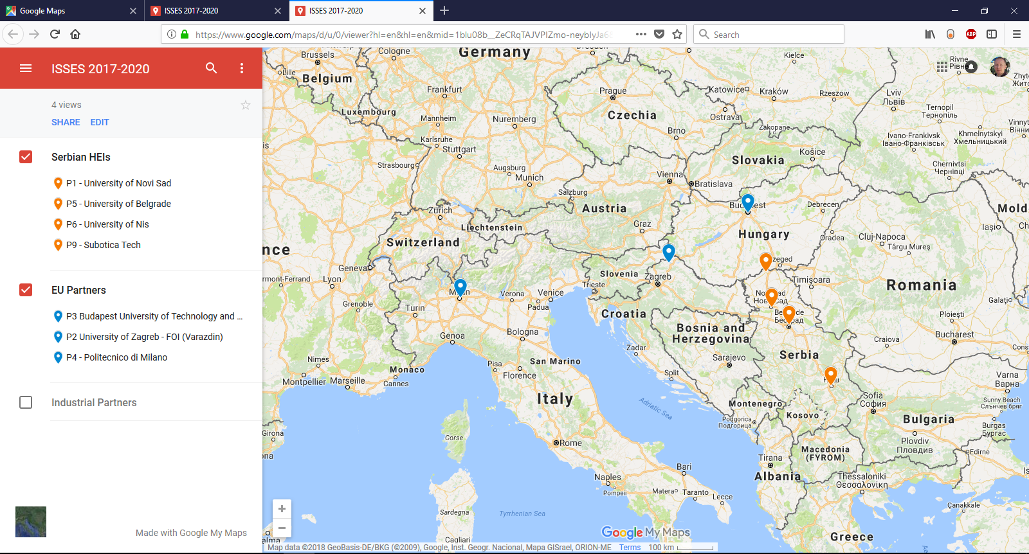
Geographic coverage

Slide 6
Associated partners
PID | Name | City | PIC
P11 | M&I Systems | Novi Sad | 919199064
P12 | Singi Engineering Ltd | Belgrade | 914898957
P13 | Evopro System Engineering | Budapest | 996332785
P14 | NetVisor | Budapest | 989553746
P15 | Advanced Security Technologies | Nis | 920915576
P16 | TIAC Ltd | Novi Sad | 936625308
P17 | Eccentrix Ltd | Belgrade
P18 | Verisec Labs d.o.o. | Belgrade
P19 | Cisco Serbia Ltd | Belgrade | 915360677
 | Microsoft Development Center Serbia | Belgrade | (almost)

Slide 7
Existing Courses @ UNS/FTN
Information Security Services Education in Serbia (ISSES)

Slide 8
“Smart Grid Security”
Course title (in English) | Security and Safety in Electric Power Systems
Course title (in Serbian) | Sigurnost i bezbednost u elektroenergetskim sistemima
BSc/MSc/PhD/Spec level of studies | BSc – 7th semester – 3+1 week block, project-based Accredited on the MSc level under a different name, but inactive in school year 2017/2018
ECTS credit points | 4
Higher education institution (HEI) | FTN – UNS
City | Novi Sad
Information security domains and concepts (5-15 elements covered by the lectures and laboratory exercises) | Introduction; Personnel & Physical Security; Cryptography overview; Secure communication channels (i.e. Network Security); AAA; Malware; Secure Software Development; Privacy and Legal aspects; Information Security Policy; Organizations & Standards;
Professor(s) – name, title, organization, email | Imre Lendak, assistant professor, FTN – UNS lendak@uns.ac.rs

Slide 9
e-Business Security
Course title (in English) | E-Business Systems Security
Course title (in Serbian) | Bezbednost u sistemima elektronskog poslovanja
BSc/MSc/PhD/Spec level of studies | BSc
ECTS credit points | 4
Higher education institution (HEI) | FTN - UNS
City | Novi Sad
Information security domains and concepts (5-15 elements covered by the lectures and laboratory exercises) | cryptography; PKI infrastructure; XML and web services security; smart card technology; application of security concepts at the level of operating systems, databases, and computer networks; authentication; access control; threat modeling
Professor(s) – name, title, organization, email | Goran Sladić, associate professor, FTN – UNS, sladicg@uns.ac.rs

Slide 10
Work Packages
Information Security Services Education in Serbia (ISSES)

Slide 11
Work Packages
ID | Phase | Description
WP1 | Preparation | Project Design
WP2 | Development | Curriculum Development
WP3 | Development | Laboratory Development
WP4 | Development | Education Programme Development
WP5 | Quality Plan
WP6 | Dissemination & Exploitation
WP7 | Management

Slide 12
WP1 – Project Design (UNS)
Period: M1 – M6 (October 15th, 2017 – April 14th, 2018)
Key outputs:
ID | Title | Institution
1.1 | Baseline Curricula Report | UB, UNS, UNI, VTS, others
1.2 | Repository of Information Security Concepts | UNS
1.3 | Course Development Plan (CDP) | UB
1.4 | Laboratory Development Plan (LDP) | UNI

Slide 13
Curriculum Development
Information Security Services Education in Serbia (ISSES)

Slide 14
WP2 – Curriculum Development (UNS)
ID | Title | Institution ?
2.1 | Critical Infrastructure Security | BME, Polimi, UNS | M13-M21
2.2 | Secure Software Development | BME, UNS, UNI | M6-M12
2.3 | Cloud Security | UNI, UNS | M24-M32
2.4 | Security and privacy in the Internet of Things | FOI, Polimi, BME, VTS | M16-M24
2.5 | Advanced Cryptography | BME, UNS, UNI | M16-M24
2.6 | Advanced Network Security | Polimi, UB/ETF | M7-M15
2.7 | Cyber Security Strategies | BME, UB/FON | M7-M15
2.8 | Security in E-business Systems | Polimi, UNS | M18-M28
2.9 | Risk Analysis and Threat Modelling | Polimi, UNS | M25-M33
2.10 | Cyber Incident Analysis and Response | FOI, UB/FON, UNS | M9-M17
2.11 | Data Mining in Digital Forensics | FOI, Polimi, UB/FON, UNS | M17-M24
2.12 | Digital Forensics Tools and Techniques | FOI, UB/FON, UNI, UNS | M13-M21
2.13 | Mobile and Multimedia Forensics | FOI, UB/FON | M22-M30

Slide 15
WP2 – Work Phases
Phase I: Introductory trainings will be carried out by P2, P3 and P4 during the preparation phase at the kick-off and Steering Committee meetings.
Phase II: More detailed trainings will be organized at the EU HEIs for the representatives of the Serbian HEIs. Teachers and researchers will analyze the course content and delivery methods (e.g. attend lectures) while onsite.
Phase III: The Serbian HEIs will work on course content at home, carefully aligning all content with the RISC (output 1.2), thereby allowing smooth projects progress and quality monitoring.
Phase IV: Additional onsite training and tuning of course content at the EU HEIs.
Phase V: Sharing the completed course content with the other Serbian HEI partners.
Phase VI: Translation of teaching materials (Power Point presentations) as the new courses will be prepared in Serbian, and they will be translated to English, as they will be accredited in both Serbian and English.

Slide 16
WP2 – Outputs
Course Development Plan (M5)
The CDP will be written in English and published as a PDF document of 15 pages.
Course-specific outputs
Course content will be documented with teaching materials (e.g. Power Point presentation) and a textbook.
Will it be necessary to modify this?
Any existing plans for books?
Shared materials between the institutions
Used by Serbian HEIs
Used by BME, FOI & Polimi as well

Slide 17
Laboratory Development
Information Security Services Education in Serbia (ISSES)

Slide 18
WP3 – Laboratory Development (BME)
ID | Title | Institution
3.1 | Lab Design: Critical Infrastructure Security Laboratory (CIS Lab) | BME/Polimi | M13
3.2 | Lab Design: Digital Forensics Laboratory (DF Lab) | FOI | M13
3.3 | Lab Design: Network Security Laboratory (NS Lab) | BME, Polimi | M13
3.4 | Lab Design: Cloud Security Laboratory (CS Lab) | ? | M14
3.5 | Hybrid CIS, CS and NS Lab implementation (P1) | UNS, BME, Polimi | M14-M24
3.6 | Hybrid NS and Crypto Lab Implementation (P5) | UB, ETF, BME | M14-M21
3.7 | NS Lab implementation (P6) | UNI, Polimi | M18-M24
3.8 | DF Lab Implementation (P5) | UB, FON | M13-M24
3.9 | DF Lab Implementation (P6) | UNI, FON | M25-M30
3.10 | DF Lab Implementation (P1) | UNS, FON | M31-M36
3.11 | Hybrid CS and IoT Lab Implementation (P9) | VTS, BME, FOI | M15-M24

Slide 19
WP3 – Work Phases
Phase I: Introductory trainings and knowledge transfer from P2, P3 and P4. Phase II: Onsite knowledge transfer about laboratory designs at partners P2, P3 and P4.
Phase III: Create Laboratory Development Plan with details about timing, trainings and other necessary inputs.
Phase IV: Create four typical laboratory designs and align them with the RISC (output 1.2), thereby allowing smooth lab development progress and quality monitoring. The plans will be revised by EU-based partners P2, P3 and P4.
Phase V: Build 7 laboratories at the four Serbian HEIs
Phase VI: Utilize the laboratories in teaching activities performed in either the new education programs or the newly developed courses.

Slide 20
WP3 Outputs
Laboratory Development Plan (LDP) in WP1
The LDP will be written in English and published as a PDF document of 15 pages.
Minimum set of elements of laboratory designs
Measuring lab implementation status – based on the RISC (output 1.2)
Additional questions:
Will we be ready to do public procurement in November 2018?
Is it too late to have the hardware and software in 2019/Q3?

Slide 21
Supporting Work Packages
Information Security Services Education in Serbia (ISSES)

Slide 22
WP4 – Program Development (UBG)
Introduce new MSc programs in information security at 3 out of 4 Serbian HEIs involved
With the support of ISSES, VTS will introduce its 1st MSc program
ID | Title | Institution
4.1 | MSc Program: Information Security in Critical Infrastructures | UNS
4.2 | MSc Program: Information Security and Digital Forensics | UB/FON
4.3 | MSc Program: Security in the Cloud and Internet of Things | VTS

Slide 23
WP5 – Quality Plan (Polimi)
Necessary element in each Erasmus+ capacity building project
Internal and external quality monitoring throughout the project lifetime
Tied with the Repository of Information Security Concepts (RISC) developed in WP1 Preparation
ID | Title | Institution
5.1 | Quality Plan | Polimi
5.2 | Annual Course Quality Report | Polimi
5.3 | Annual Laboratory Build Report | BME
5.4 | Quality Board Meeting
5.5 | External Quality Assessment | Polimi

Slide 24
WP6 – Dissemination & Exploitation (UBG)
ID | Title | Institution
6.1 | Dissemination Plan (DP) | UB/ETF
6.2 | Exploitation Plan (EP) | UB/ETF
6.3 | Annual Project Workshop | UB/ETF
6.4 | Mass Media Dissemination | UB/ETF & UNS
6.5 | Security Services Roundtable | UB, UNS, UNI, VTS
6.6 | Web portal setup and maintenance | UB/ETF

Slide 25
WP7 – Project Management (UNS)
ID | Title | Institution
7.1 | Brussels Kick-of Meeting – January 29-30, 2018 | UNS
7.2 | Project Kick-off Meeting – December 13-14, 2017 | UNS
7.3 | Project Steering Committee Meeting
7.4 | Project Coordination | UNS
7.5 | Financial Plan | UNS
7.6 | Interim and Final Report | UNS

Slide 26
Summary
Introduction
Existing courses
Work packages
Curriculum development
Laboratory development
Supporting work packages

